Slide 1
Research on TCAM-based OpenFlow Switch
Author: Fei Long, Zhigang Sun, Ziwen Zhang, Hui Chen, Longgen
Liao
Conference: 2012 International Conference on Systems and
Informatics (ICSAI 2012)
Presenter: Chih-Hsun Wang
Date: 2015/09/16
Department of Computer Science and Information Engineering
National Cheng Kung University, Taiwan R.O.C.
Notes:
1

Slide 2
Introduction
Multi-table and multi-item group matching is the challenge in Openflow platform.
This paper presents a three-layer realization model of Openflow switches, TCAM-based multi-table forwarding.
The Openflow multi-table description and the performance analysis of TCAM lookup function is proposed.
Netlogic's Ayama20000 TCAM is used as an example to anaylize the performance of Openflow switch.

Slide 3
The Design of Three-layer Model
After the release of version 1.1 specification, Openflow has increased multi-table, the port group, scalable matching and other new features.
But based on the new specification, less switch models can be realized.
According to the characteristics of the new specification, we have designed a three-tier structure based on hardware layer, core layer, user layer to realize.

Slide 4
The Design of Three-layer Model
Hardware Layer
Uses TCAM and related SRAM to realize to lookup ACL rapidly and to routing table.
Realize accelerating logic functions by FPGA chip in hardware receiving and transmitting, meanwhile, implement packet analysis in hardware receiver modules by which to lookup hardware or software according to the rules of OpenFlow.

Slide 5
The Design of Three-layer Model
Core Layer
Sets five modules:
  Rule management process
  OpenFlow rule table
  OpenFlow rules mapping table
  Forwarding thread management
  Statistical counters.
    to achieve OpenFlow specifications for each flow, flow table and port, etc.
Notes:
主要藉由API完成與controller的互動；controller需要將operating table傳到hardware layer；有Update時，需要傳送update資訊給OF table
使用Hash演算法達到在沒有wildcard的15個group的查詢
主要是備份資料以及達成一些其他的擴充，像是timeout updating
主要是在三layer間傳送data stream
會放在這層是考慮到storage space and resources consumption

Slide 6
The Design of Three-layer Model
User Layer
The main achievement is the user-layer OpenFlow controller, users can change switch configuration by controller.
These three-layer models can not only achieve fifteen fields to complete the current matching, but also can support the current use of the normal rules of network data packets.

Slide 7
The Design of Three-layer Model
We can also configure the hardware layer over TCAM with the Aging combined with the rules of the core layer mapping table to achieve a better standard of OpenFlow hard timeout and idle timeout.
Notes:
Idle timeout: Flow在switch中，沒被match可停留的時間
Hard timeout: Flow在switch中可停留的時間，不管有無被match

Slide 8
Three-layer Model
Openflow controller
User Layer
OF Rules
database
API
API
Kernel Layer
Rule
Management
Process
OF Rules table2
(Hash Tables)
Forwarding
Management
Threads
Statistics
Counters
OF Rules
mapping table
Hardware Layer
Hardware
Receive
Hardware to
transmit
TCAM OF Rules table
SRAM(Instructions and Action set)
(Includes multi-table,
Every field could be wildcard)
Notes:
1. Packet 進來會先去TCAM lookup , 若rule match會forward去找對應的指令，及forward到FM去update counter
2. FM
to OpenFlow rule table forwarding rules in Table 2 (without a
wildcard hash to look-up table). If the rules match, issue from
the hardware forwarding process, and sent to the forwarding
management to update the counter.
若都找不到就會去跟controller要
controller 會丟給rule management去寫入
On user layer, set up a ruler database of Openflow to backup and modify configuration.

Slide 9
TCAM Performance Analysis and Model
The following table defines the parameters associated with
TCAM character description.
Symbolic name | Units | Description
v | - | TCAM rate per second
T | ns | Clock cycle
TP | ns | Processing time for a single table
C | ns | TCAM share of beats in command
W | bit | TCAM write the bit width of each shot number
R | ns | SRAM share return the number of beats
B | bit | TCAM width of the base to process packets
PE | - | The number of packet processors

Slide 10
TCAM Performance Analysis and Model
The following table describes the use of multi-table of
OpneFlow: Suppose OpenFlow switches has
<RN₁,RN₂~RN_{n}> tables, each table has three subsets of
attributes <RL_{i},RN_{i},RM_{i}>, RL_{i} means the rules of length,
RN_{i} means the number, RM_{i} means the rules whether contains
the mask match, 1 means including, and on contrary for 0.
Symbolic name | Units | Description
RN_{i} | - | The number of table
RN_{n} | - | TCAM table in the n
RL_{i} | bit | The length of the table
D | ns | System delay time
DS | ns | Single table system delay
E | - | Resource utilization
N | - | The total number of table

Slide 11
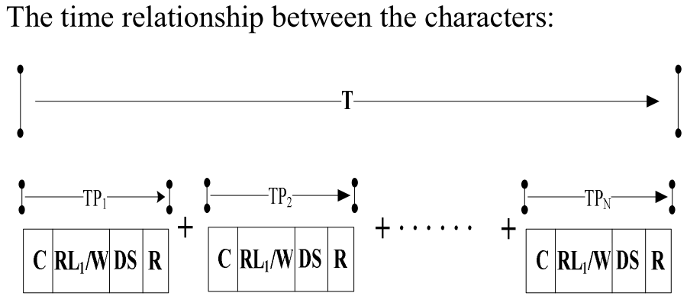
TCAM Performance Analysis and Model
clock cycles
process time
for a single table
Notes:
C: TCAM share of beats in command
RLi: The length of the table
W: TCAM write the bit width of each shot number
DS: Single table system delay
S: SRAM share return the number of beats

Slide 12
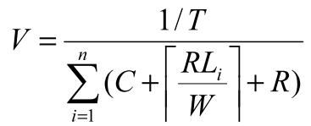
TCAM Performance Analysis and Model
TCAM Performance Analysis
By deriving the performance of TCAM can get the forwarding rates and the total number of resource occupying of different tables.
The TCAM with maps to TCAM, the length are RL₁, RL₂ ~ RL_{n} for each. The clock period is T, Then we can get the rate of per second by formula.
Notes:
C: TCAM share of beats in command
RLi: The length of the table
W: TCAM write the bit width of each shot number
DS: Single table system delay
S: SRAM share return the number of beats

Slide 13
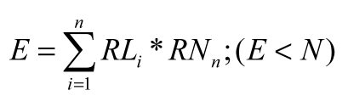
TCAM Performance Analysis and Model
TCAM Performance Analysis
We can multiply the table’s length RL_{i} with its number RN_{n} to get the total numbers of the occupying resource rate of inner TCAM.
Notes:
C: TCAM share of beats in command
RLi: The length of the table
W: TCAM write the bit width of each shot number
DS: Single table system delay
S: SRAM share return the number of beats

Slide 14
TCAM Performance Analysis and Model
TCAM-based packet processor set
Each TCAM has a different type of bus bandwidth, if we want to make full use of TCAM, its bus can’t be idle.
We need to calculate the delaying time of TCAM, then to design a reasonable PE according to delay.
In order to solve the problem, we designed a general TCAM model.
Notes:
PE: The number of packet processors

Slide 15

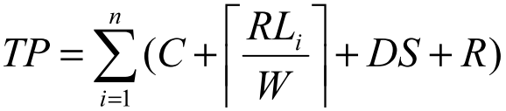
TCAM Performance Analysis and Model
TCAM-based packet processor set
First, get a general system delay.
Second, we can get the entire processing time that message through TCAM.
Secondly, we can get the message through the entire TCAM processing time required:
single table
system delay
TCAM width of the
base to process packets
processing time
for a single table
Notes:
DS: Single table system delay
TP: Processing time for a single table
B: TCAM width of the base to process packets

Slide 16
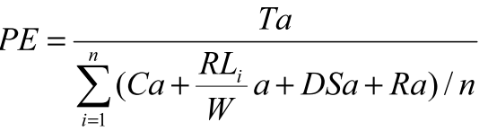
TCAM Performance Analysis and Model
TCAM-based packet processor set
We set a period : a, then we get the following formula:
Number of packet
processors
Notes:
PE: number of packet processors
考慮PE的功用，我們要選擇運作模式是linear or concurrent，若選擇linear mode，很容易因為單一node錯誤導致bottleneck
若是concurrent，總bandwidth數須小於chips的bandwidth

Slide 17
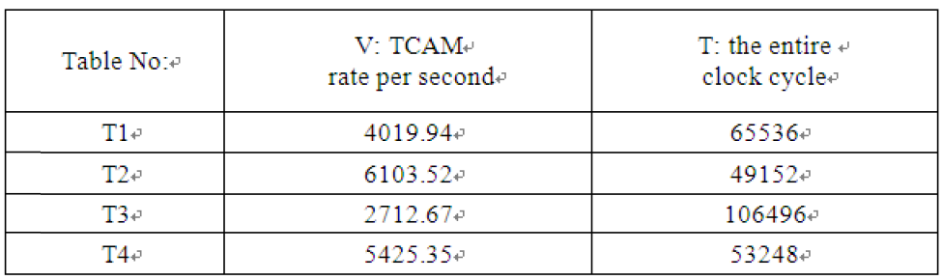
TCAM Performance Analysis and Model
The parameter calculation of Ayama20000
There are four tables in Openflow switch:
T1 = <128, 8K, 1>; T2 = <64, 8K, 1>; T3 = <512, 4K, 1>; T4 = <512, 2K, 1>, TCAM in Ayama20000 series
writes width W = 32, C = 1, R = 1, DS = {2, 4, 8, 8}

Slide 18
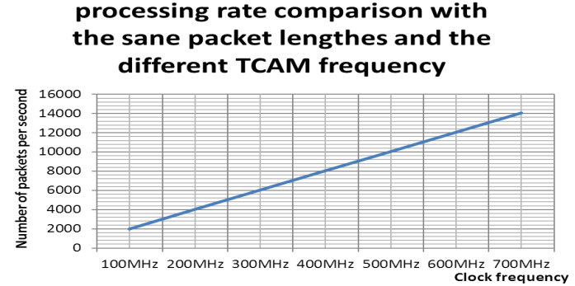
TCAM Performance Analysis and Model
The parameter calculation of Ayama20000
We use 128bit packet processing width with different
clock cycles to obtain the following graph:

Slide 19
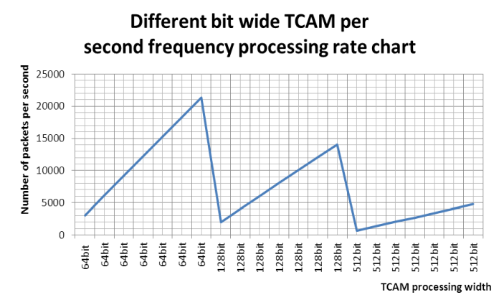
TCAM Performance Analysis and Model
The parameter calculation of Ayama20000
with 64bit, 128bit, 512bit packet processing width and the
same clock cycle, as following graph:

Slide 20
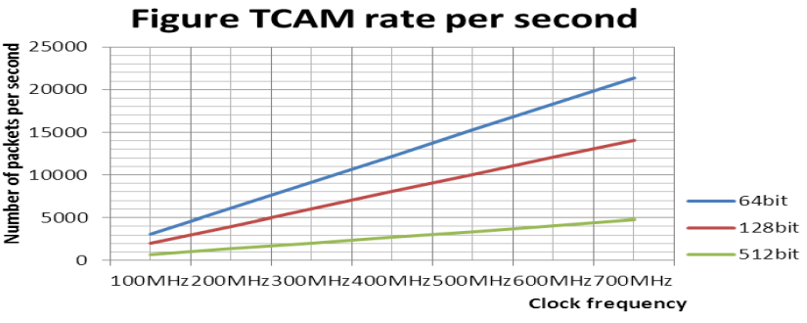
TCAM Performance Analysis and Model
The parameter calculation of Ayama20000
with 64bit, 128bit, 512bit different packet width of three
tables and the clock cycles of 100MHz ~ 700MHz to calculate

Slide 21
Design and Implementation of TCAM-Based
The TCAM-based establishment of multi-table
Ayama 20000 contains a core with 9M or 18M.
The core supports 256K72-Bit 18M, 128K72-Bit 9M.
Each TCAM has 72bit data fields and 72bit mask field.
To complete OpenFlow with 18M of TCAM, they can be 512K, 256K, 128K, 64K and 32K with the width of 32bits, 72bits, 144bits, 288bits and 576bits width.
Compare with OpenFlow, its fields contain 356bit.

Slide 22
Design and Implementation of TCAM-Based
The TCAM-based establishment of multi-table
However, in the flow table, including 15 fields, two timeout bit, group, port and queue, which means position and handle position with 576bit.
The Ayama 20000 have two QDR™SRAMs, we can store instruction set in OpenFlow’s management.

Slide 23
Design and Implementation of TCAM-Based
The TCAM Aging-based Timeout achievement
TCAM Aging helps to track the currently used table.
Ayama 20000 supports aging with 256K at most, these tables may exists in one, two, or four lookup tables, which have an aging memory module to store aging information.
The module is partition SRAM of 4K *64bit. Every bit in it corresponds to a lookup table to store aging information.
Notes:
每次lookup會將對應到的aging bit標記為visited，packet processor必須一段時間就來讀一次aging memory entries

Slide 24
Design and Implementation of TCAM-Based
The TCAM Aging-based Timeout achievement
The aging table divides into two models:
First, the single buffer mode which processes the same time with reading aging mechanism. The model has two settings. One reads information for a period of time, and then stop to age. Then go on reading the whole table.
Second, the double buffering mode. Table A is divided into A, B parts. To complete reading and aging alternately at the same time by A, B table reading each other. But the model must be limited in 32K.

Slide 25
Design and Implementation of TCAM-Based
The TCAM Aging-based Timeout achievement
OpenFlow are idle timeout and hard timeout, their relative setting as following:
  If the idle timeout configured, the idle timeout setting will age without receiving dataflow.
  If hard timeout sets, it ages, no matter received the data flow or not.
  If both set, the flow will age without data flow via the time of idle timeout or aging after hard timeout, no matter which one gets first.
  If neither sets, the table will be effective permanently without overtiming, but you can remove list item by the data packets of OFPFC-DELETE. .

